Slide 1
The history of fashion: 1930-1939
By Emily L. Voigt

Slide 2
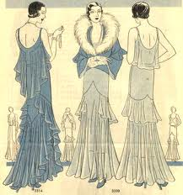
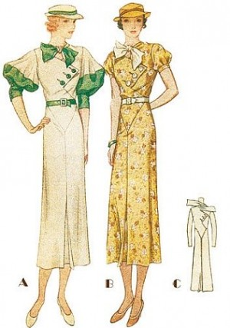
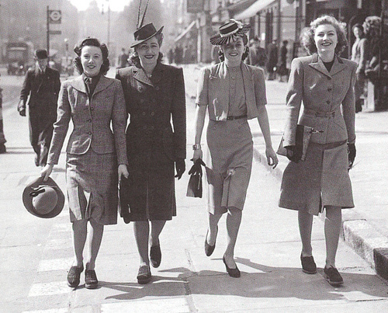
Types of dress: 1930-1939
Women
Cotton became a more commonly used fabric after the fashion designer, Channel, utilizes if for more semi-formal wear.
The draping of fabric was a very common style in the 1930’s. Also skirts and dresses were often shorter in the front and much longer in the back.
Women wore much more practical clothing with square shoulders and low heels as a reaction to the talk of war over in Europe.

Slide 3
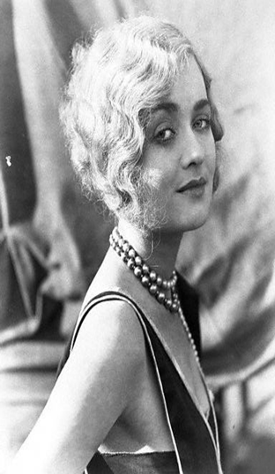
Hairstyles: 1930-1939
Women
Elaborate finger waves were a commonly worn hairstyle in 1930’s Hollywood.
Women also chose to keep their hair very, very short!

Slide 4
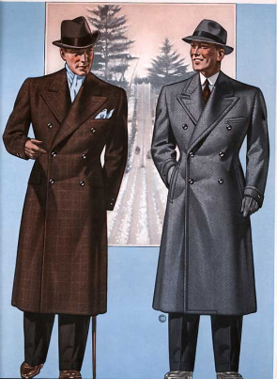
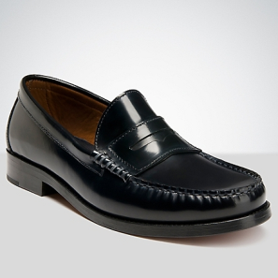
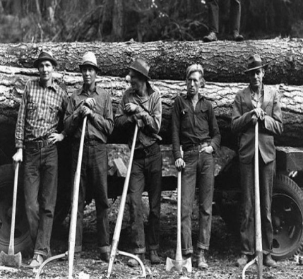
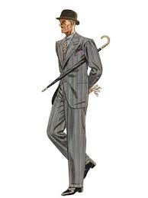
Types of dress: 1930-1939
Men
A fashion designer named, Schiaparelli, made the use of zippers increasingly more common in everyday clothing.
Men’s suits were made to use as little fabric as possible and were made in dim colors such as browns and greys.
The trend of brown and black loafers began in the 1930’s. Working men often wore boots.
Common accessories for men were umbrellas, silk handkerchiefs, and leather gloves.

Slide 5
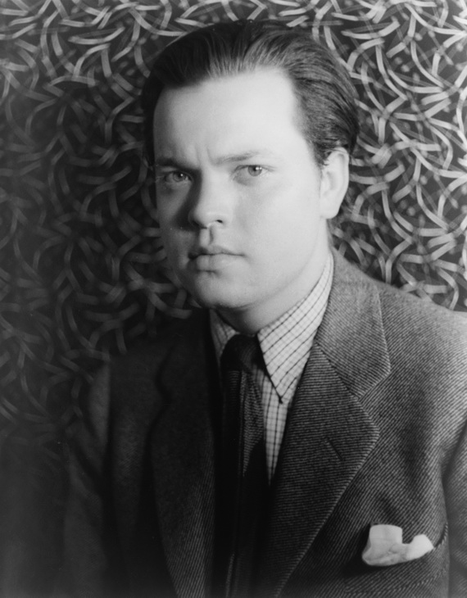
Hairstyles: 1930-1939
Men
Men in the 1930’s wore their hair gelled back and kept it very short.

Slide 6
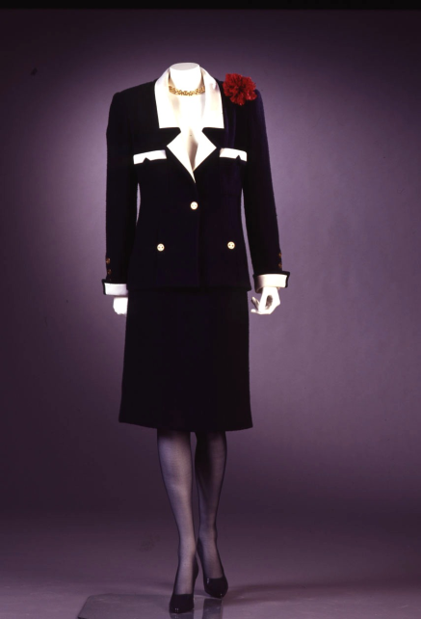
Channel in the 1930’s
Coco Channel was a major fashion designer in the 1930’s. Channel was most known for her menswear inspired clothing line. This clothing line featured her most famous color patterns of black and beige, navy and white, and burgundy and white.

Slide 7
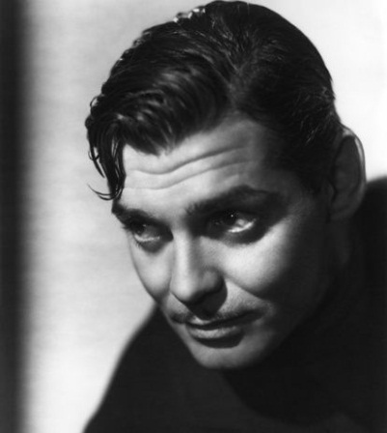
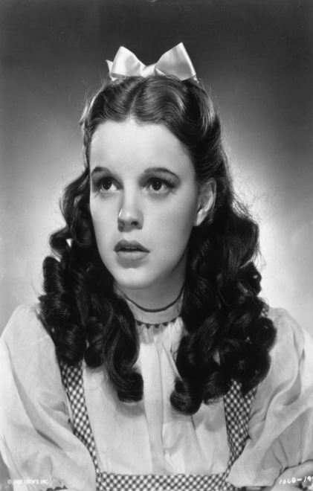
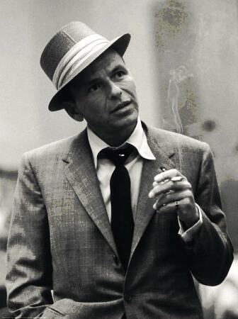
Celebrities of the 1930’s
Clark Gable movies influenced men to rid themselves of their undershirts.
Frank Sinatra always wore his hair gelled back and a suit and tie, this was his signature look.
Judy Garland, after acting in The Wizard of Oz, started wearing bold prints and kitten heels.

Slide 8
Inventions of the 1930’s
The FM radio was invented by Edwin Howard Armstrong. (1933)
Joseph Begun invents the first tape recorder for broadcasting. (1934)
Wallace Carothers and DuPont Labs invents nylon. (1935)
Bell Labs invents the voice recognition machine. (1936)
Chester F. Carlson invents the photocopier. (1937)
LSD was synthesized on November 16, 1938 by Swiss chemist Albert Hofmann of Sandoz Laboratories. (1938)
Igor Sikorsky invents the first successful helicopter. (1939)

Slide 9
Major events: 1930-1939
The Great Depression
The Dust Bowl
Germany and Italy fell to into dictatorship
The Social Security Act of 1935
The Wagner Act of 1935

Slide 10
The Great depression and the dust bowl:
The Great Depression was a very sad economic time for America. This sudden slump in the economy put many, many Americans out of work and decreased the pay of Americans who were still able to keep their jobs. Another issue in the 1930’s was the Dust Bowl. The Dust Bowl put independent farmers out of work and sent them to find work somewhere else. Dust Bowl farmers packed up their families and went to the city to find work. The “American Dream” became a thing of the past and survival became the number one necessity. For a while the Great Depression and the Dust Bowl kept many out of work Americans from having to luxury of nice clothes to wear whenever they pleased. So this sad time in the 1930’s made many designers color palates much more melancholy than usual.

Slide 11
Dictatorship and Acts of 1935:
Italy and Germany fell to dictatorships in place of democracies, while America still pushed on. The Social Security Act of 1935 was set in motion to ensure elderly people would have some sort of income. The Wagner Act of 1935 gave workers the right to unionize and go on strike against their management. These world events caused designers to start up the military style of dress. Square shoulder pads and low heels for women, made the style much more practical and functional.

Slide 12
Summary:
Women’s style in the 1930’s was mainly short wavy hair, backless evening gowns with draping skirts, low hells for day wear, broad shoulder pads in male inspired work clothes, and very dim melancholy colors.
Men’s style in the 1930’s was mainly short slicked back hair, taken in suits (to use less fabric), shiny leather loafers or work boots, and accessories such as, hats, umbrellas, and handkerchiefs.

Slide 13
Work Cited:
http://kclibrary.lonestar.edu/decade30.html
http://www.fashion-era.com/stylish_thirties.htm
http://www.google.com/imgres?um=1&hl=en&sa=N&biw=1280&bih=923&tbm=isch&tbnid=jHDhn7yTwnkSBM:&imgrefurl=http://www.furinsider.com/new-york-fashion-week-part-2-making-the-mark/&docid=8l0fAntjgcMW_M&imgurl=http://www.furinsider.com/wp-content/uploads/2012/01/women40.jpg&w=500&h=403&ei=gz5SUMXGLoeW2QXuyIDAAg&zoom=1&iact=hc&vpx=322&vpy=228&dur=1507&hovh=201&hovw=250&tx=142&ty=131&sig=110409269255664537297&page=3&tbnh=157&tbnw=202&start=59&ndsp=32&ved=1t:429,r:14,s:59,i:375
http://www.google.com/imgres?um=1&hl=en&sa=N&biw=1280&bih=923&tbm=isch&tbnid=ILLksQg40wQePM:&imgrefurl=http://www.100megspop3.com/adira/1930s.html&docid=0CgFKhuhvwdwpM&imgurl=http://www.100megspop3.com/adira/1930butterickh.jpg&w=472&h=506&ei=gz5SUMXGLoeW2QXuyIDAAg&zoom=1&iact=hc&vpx=1022&vpy=88&dur=80&hovh=232&hovw=217&tx=142&ty=123&sig=110409269255664537297&page=1&tbnh=163&tbnw=159&start=0&ndsp=25&ved=1t:429,r:5,s:0,i:156
http://www.google.com/imgres?um=1&hl=en&sa=N&biw=1280&bih=923&tbm=isch&tbnid=5bKCytsFEc6ssM:&imgrefurl=http://www.thelovecollage.com/2010/08/28/channelling-1930s-fashion/&docid=weNk-fT_o2fzgM&imgurl=http://www.thelovecollage.com/wp-content/uploads/2010/08/1930s-silhouette.jpg&w=300&h=427&ei=gz5SUMXGLoeW2QXuyIDAAg&zoom=1&iact=hc&vpx=415&vpy=467&dur=299&hovh=197&hovw=138&tx=84&ty=101&sig=110409269255664537297&page=2&tbnh=152&tbnw=107&start=25&ndsp=34&ved=1t:429,r:15,s:25,i:270
http://www.ehow.com/list_7451491_men_s-fashion-1930s.html
http://www.google.com/imgres?num=10&um=1&hl=en&sa=N&biw=1280&bih=923&tbm=isch&tbnid=4H110c9A6q-xQM:&imgrefurl=http://www.esquire.com/style/style-evolution-0908&docid=RAd74Rim0GD2IM&imgurl=http://www.esquire.com/cm/esquire/images/1933-autumn-esquire-style-l.jpg&w=300&h=400&ei=20BSUP_PG4jk2wW5-YGABA&zoom=1&iact=rc&dur=294&sig=110409269255664537297&page=1&tbnh=167&tbnw=125&start=0&ndsp=25&ved=1t:429,r:0,s:0,i:141&tx=99&ty=59
http://www.google.com/imgres?um=1&hl=en&biw=1280&bih=923&tbm=isch&tbnid=njgdXtF2K4B4kM:&imgrefurl=http://www.guystyleguide.com/2011/11/essential-men%25E2%2580%2599s-dress-shoes/&docid=v4_vdbThFWvwcM&imgurl=http://www.guystyleguide.com/wp-content/uploads/2011/11/mensblackloafer.png&w=451&h=451&ei=IUFSUPO3J8fc2AXL6YCoAg&zoom=1&iact=hc&vpx=1014&vpy=133&dur=1049&hovh=225&hovw=225&tx=128&ty=148&sig=110409269255664537297&page=1&tbnh=132&tbnw=138&start=0&ndsp=32&ved=1t:429,r:5,s:0,i:87
http://www.google.com/imgres?um=1&hl=en&biw=1280&bih=923&tbm=isch&tbnid=1Q2w0r85VJGPdM:&imgrefurl=http://25dollarvintage.blogspot.com/2010_06_01_archive.html&docid=vpjVLJ01RVGy0M&imgurl=http://3.bp.blogspot.com/_Vi9I1mrPbJk/TCo0gQ7BbYI/AAAAAAAAAl8/ZyebXkMoslI/s1600/model137.jpg&w=527&h=720&ei=X0FSUKuqOcOq2gX_v4GYBA&zoom=1&iact=rc&dur=589&sig=110409269255664537297&page=1&tbnh=167&tbnw=135&start=0&ndsp=25&ved=1t:429,r:1,s:0,i:141&tx=112&ty=68
http://www.google.com/imgres?start=94&um=1&hl=en&biw=1280&bih=923&addh=36&tbm=isch&tbnid=nzM9qDx9gjEd1M:&imgrefurl=http://blog.lyleandscott.com/%3Fp%3D4026&docid=B0LM0Z9SSxQe1M&imgurl=http://blog.lyleandscott.com/wp-content/uploads/1930s-workwear.jpg&w=675&h=476&ei=yUFSUI6CB4X02wX2_YDACQ&zoom=1&iact=rc&dur=478&sig=110409269255664537297&page=4&tbnh=159&tbnw=230&ndsp=29&ved=1t:429,r:22,s:94,i:75&tx=146&ty=67
http://www.fashionfizz.com/QA/13-1930_s_fashion-0.html
http://www.google.com/imgres?hl=en&sa=X&noj=1&tbm=isch&prmd=imvnso&tbnid=X134osK5yWCtJM:&imgrefurl=http://mintwiki.pbworks.com/w/page/33455840/Chanel%253A%2520Designs%2520for%2520the%2520Modern%2520Woman&docid=fuzU0L0OhdaT5M&imgurl=http://mintwiki.pbworks.com/f/1300136298/1980s%252520Coco%252520Chanel%252520Suit.JPG&w=855&h=1255&ei=uDpTUK67KcOZ2QXL2YCQBg&zoom=1&iact=hc&vpx=285&vpy=414&dur=289&hovh=129&hovw=88&tx=114&ty=120&sig=111846734164495505503&page=1&tbnh=129&tbnw=88&start=0&ndsp=41&ved=1t:429,r:18,s:0,i:131&biw=1280&bih=923
http://www.google.com/imgres?num=10&um=1&hl=en&safe=active&biw=1280&bih=880&tbm=isch&tbnid=q1OvAv7F8ScKsM:&imgrefurl=http://www.guciimage.com/store/home.php%3Fcat%3D115&docid=6QgE7US7utASjM&imgurl=http://www.guciimage.com/store/images/T/Picture%252520011.jpg&w=580&h=576&ei=i3dXUM79Eeak2gW09IEY&zoom=1&iact=hc&vpx=333&vpy=488&dur=2200&hovh=224&hovw=225&tx=141&ty=135&sig=110409269255664537297&sqi=2&page=1&tbnh=164&tbnw=169&start=0&ndsp=28&ved=1t:429,r:15,s:0,i:119
http://www.google.com/imgres?num=10&um=1&hl=en&safe=active&biw=1280&bih=880&tbm=isch&tbnid=eV0y7sxaVUbTrM:&imgrefurl=http://advanceportfolio1123.blogspot.com/2011/01/hair-and-makeup-jewelery-1930s-style.html&docid=GjWD3O1X6_qeRM&imgurl=http://4.bp.blogspot.com/_j33rHQTZUG0/TUXC5z7_8aI/AAAAAAAAAIM/fz9-x91CCNs/s1600/ConstanceBennett2.jpg&w=384&h=480&ei=i3dXUM79Eeak2gW09IEY&zoom=1&iact=hc&vpx=890&vpy=250&dur=3473&hovh=251&hovw=201&tx=100&ty=177&sig=110409269255664537297&sqi=2&page=1&tbnh=163&tbnw=131&start=0&ndsp=28&ved=1t:429,r:26,s:0,i:153
http://cdn.stylisheve.com/wp-content/uploads/2011/12/1930s-Hairstyles-for-men_07.jpg
http://inventors.about.com/od/timelines/a/twentieth_4.htm
http://www.stylelist.com/2012/06/10/judy-garlands-style-evolution_n_1577393.html#slide=1063225
http://www.google.com/imgres?num=10&hl=en&biw=1280&bih=880&tbm=isch&tbnid=-heU9CBHnXbS0M:&imgrefurl=http://www.rottentomatoes.com/celebrity/clark_gable/&docid=RpTBp0tHSfqEjM&imgurl=http://content6.flixster.com/photo/10/04/84/10048436_ori.jpg&w=414&h=462&ei=Yn9XUOn6O8Xs2AWJhYDACg&zoom=1&iact=hc&vpx=922&vpy=173&dur=2310&hovh=237&hovw=212&tx=73&ty=158&sig=110409269255664537297&page=1&tbnh=153&tbnw=139&start=0&ndsp=28&ved=1t:429,r:5,s:0,i:156
http://www.google.com/imgres?um=1&hl=en&sa=N&biw=1280&bih=880&tbm=isch&tbnid=OqMd91tDgnj_bM:&imgrefurl=http://mubi.com/topics/the-auteurs-film-cast-member-database%3Fpage%3D4&docid=WGkv9sBfyrN8cM&imgurl=http://www.boston.com/ae/sidekick/blog/frank%252520sinatra.jpg&w=336&h=450&ei=tIBXUIDTHqHL2QW4yIHQAQ&zoom=1&iact=hc&vpx=521&vpy=294&dur=1228&hovh=260&hovw=194&tx=117&ty=157&sig=110409269255664537297&page=1&tbnh=172&tbnw=129&start=0&ndsp=27&ved=1t:429,r:8,s:0,i:100

